Slide 1
U1M2L3 CONSERVATION OF ENERGY

Slide 2
What types of energy does an object have if it is both moving and off the ground?
Kinetic energy and potential energy are two classifications of energy. Think about a pendulum.
As the pendulum swings back and forth, what types of energy does it have? Can it have more than one type of energy?

Slide 3
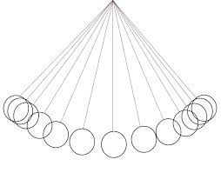
Mechanical Energy
When a pendulum is swinging, it has mass and speed. So it has kinetic energy. When a pendulum is above its resting height, it has gravitational potential energy.
The pendulum has both kinetic and potential energy. The sum of the potential energy and the kinetic energy in a system is mechanical energy. All forms of energy are measured in joules (J)

Slide 4
Changes Between Kinetic and Potential Energy
When objects change motion, kinetic energy changes to potential energy and vice versa.
Think about tossing a basketball in the air. The ball is moving fastest and has the most kinetic energy as it leaves your hand. As the ball moves upward, its speed and kinetic energy decrease. However, the potential energy is increasing because the ball’s height is increasing. Kinetic energy is changing into potential energy.
At the ball’s highest point, the gravitational potential energy is at its greatest, and the ball’s kinetic energy is at its lowest.

Slide 5
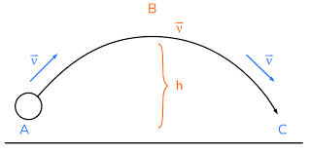

Slide 6
The figure shows these changes. Notice that at the ball’s highest point, it has the most potential energy because it is farthest from the ground. As the ball moves downward, its potential energy decreases because its height decreases. At the same time, the ball’s kinetic energy increases because its speed increases. As the ball drops, potential energy changes to kinetic energy. When the ball reaches the boy’s hands, the ball’s kinetic energy is at the highest value again.

Slide 7
Online simulation
https://phet.colorado.edu/en/simulations/energy-skate-park
https://phet.colorado.edu/sims/html/projectile-motion/latest/projectile-motion_en.html

Slide 9
Energy changes / Conservation of Energy
The ball’s total energy does not change.
Energy bars are shown at each point of the golf ball’s motion. As the ball takes off, kinetic energy is greatest and potential energy is lowest. The total energy bar is full. As the ball moves up, kinetic energy decreases and potential energy increases.
The total energy remains the same.
At the highest point, gravitational potential energy is greatest and kinetic energy is lowest. But total energy is still unchanged.
This pattern continues as the ball moves downward. The decrease in gravitational potential energy and increase in kinetic energy does not change the overall amount of energy as the ball nears the ground. The law of conservation of energy states that even though energy is always transferring, energy is not created and energy is not destroyed.

Slide 11
How does energy transfer into or out of a system?
As the object moves, kinetic energy and potential energy can transfer from one object to another without being lost.
Think about a pendulum again. How does the pendulum get the energy to start swinging? If you want to increase the energy of an object, where does that energy come from?

Slide 12
Energy Transfer Signs
A change in an object’s motion is a sign that an energy transfer occurred between objects. If you drop a box full of objects, you will likely hear a crashing sound. Some of the mechanical energy was used to create a vibration that was heard as sound.
A change in the sound of a system is also a sign that an energy transfer occurred.

Slide 13
Transferring Energy
A force is a push or a pull.
When a force is applied to an object, the object’s kinetic and potential energy can change. You can transfer this energy when you do work.
Work is the transfer of energy to an object by a force that makes the object move in the direction of the force. Work is only being done while the force is applied to an object

Slide 14
The girl does work on the box as she lifts it. As she lifts the box onto the shelf, the energy of the box changes. The work she does transfers energy to the box. The energy of the box increases because of the gravitational interaction between the box and Earth. The box’s potential energy increases as she lifts the box higher. The vertical bars in the figure show the work that the girl does (W) and the box’s potential energy (PE). Work depends on force and distance.

Slide 15
You do work on an object only if the object moves. Imagine the girl shown in the figure tries to lift the box but cannot lift it off the floor. Then she does no work on the box and transfers no energy

Slide 16
Energy
An object that has energy can also do work. What will happen if the girl drops the box as she is moving it onto the shelf?
When the box hits the floor, it does work on the floor. Some of the box’s kinetic energy is transferred to the floor. The girl will hear some of the energy as a loud crash and feel some of the energy near her feet as the energy travels through the floor.
Because energy and work are connected, energy is sometimes described as the ability to do work.

Slide 17
Doing Work
Imagine pushing your bicycle into a bike rack. Your push (a force) makes your bicycle (an object) move. Therefore, work is done. You do no work if you push on the bicycle and it does not move.
A force that does not make the object move does no work. Now, suppose you let go of the bicycle and it continues moving forward. The bike is still moving, but you did not apply a force so no work is being done.
Energy can be transferred into a system when a force does work on the object.

Slide 18
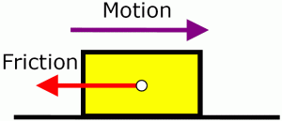
What causes energy to be transferred out of a system?
Thermal Energy Transformations
Have you ever heard the phrase burning rubber?
The tires of race cars are made of rubber. The tires and the road are in contact, and they move past each other quickly. Recall that friction is a force between two surfaces in contact with each other. The direction of friction is in the opposite direction of the motion.

Slide 19
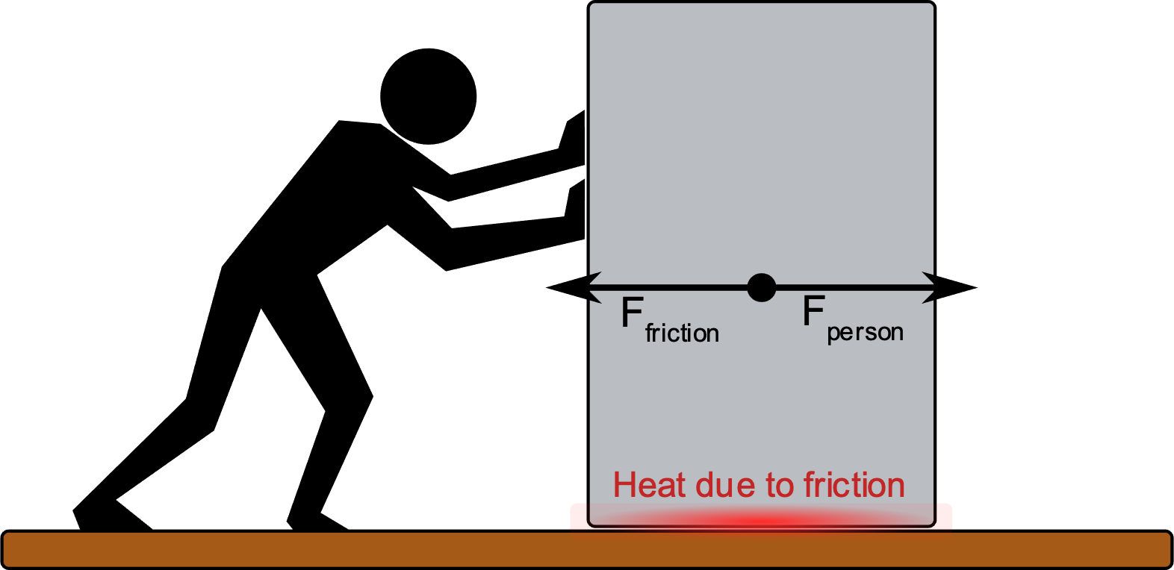
Friction between a car’s tires and the road causes some of the kinetic energy of the tires to transform into thermal energy. If race cars are moving very quickly, thermal energy in the tires causes the rubber to give off a burnt odor

Slide 20
Transformation vs. transfer
As a race car moves, energy is transformed and transferred.
For example, a car’s engine transforms energy from fuel and transfers it to the wheel axle.
In every energy transformation and every energy transfer, some energy is transformed into thermal energy. This thermal energy is transferred to the surroundings. A change in temperature is another sign that an energy transfer has occurred

